Slide 1

Title : Fake News Detection Using Pattern Matching
Student Name: D. Ananya
Student ID: 2520090011
Cluster: 4
Section: 15
Under the Guidance
of
Supervisor Name: Mrs. Surekha
Assistant Professor
Department of CSIT

Slide 2
OUTLINE
Abstract
Existing System
Proposed System
System Architecture
Project Modules
Objectives
Co’s Attainments - FWD
Co1
Co2 …….. 5. Co5
Co’s Attainments - DSA
Co1
Co2 …….. 5. Co5
Screen Shots for FWD & DSA
Conclusion
Geo-Tagged Photos

Slide 3
Abstract
Fake News Detection Using Pattern Matching is a web application developed using HTML, CSS, and JavaScript.
It helps users identify whether a news article is fake or real.
The system analyzes the news text and checks for susupicious keywords and patterns commonly found in fake news.
It uses pattern matching techniques to compare their input news with predefined fake news patterns .
The system can be useful for students, researchers, journalists and social media users.
The project helps reduce the spread of misinformation on the internet.

Slide 4
Existing System
In the existing system, people usually verify news manually by checking different websites, news channels, or social media platforms. They compare the information from multiple sources to decide whether the news is real or fake. Problems in existing system:
Time-consuming process
Difficult to verify news quickly
High chance of spreading misinformation
No automatic detection system.
Requires checking multiple scores manually
Difficult to analyze large amounts of news content

Slide 5
Proposed System
The proposed system provides an automated web-based solution for detecting fake news using pattern matching techniques.
Features:
User interface to enter or paste news text for verification
Pattern matching algorithm to analyze suspicious keywords and phrases
Automatic detection of fake or genuine news based on predefined patterns
Quick result display showing whether the news is fake or real
Helps users verify information before sharing it online
Reduces the spread pf misinformation on digital platforms

Slide 6
System Architecture
Built using HTML and CSS for the user interface, including the news input page and result display page.
Client Logic: JavaScript processes the news text entered by the user and performs pattern matching analysis.
Pattern Matching: The system checks the text for suspicious keyword, phrases and patterns commonly found in fake news.
Data Handling: Predefined fake news patterns or keyword lists are used to compare with the input news content.
Output: System analyzes the text and displays whether the news is likely fake or genuine to the user.

Slide 7
Project Modules
News Authentication Module: Allows users to enter or paste text for verification.
Text Analysis Module: Analyzes the news content and prepares the text for pattern matching.
Pattern matching Module: Compares the input text with predefined fake news keywords and patterns.
Detection Module: Determines whether the news is fake or genuine based on the matching results.
Result Display Module: Shows the analysis result to the user clearly.
Data Handling Module: Manges the keyword list or pattern data used for fake news detection.

Slide 8
Objectives
To develop a web-based system for fake news detection.
To analyze news content using pattern matching techniques.
To automatically detect whether the news is fake or genuine.
To implement HTML, CSS, and JavaScript concepts in a real project.
To analyze text by checking suspicious keywords and patterns.
To provide quick and accurate results to the user.
To help reduce the spread of misinformation digital platforms.

Slide 9
Co’s Attainments - FWD
CO1: Implemented HTML structure and CSS styling to design the web interface.
CO2: Used HTML forms, input fields, and tables for user interaction and data input.
CO3: Applied JavaScript fundamentals such as variables, functions, conditions, arrays, and objects.
CO4: Implemented DOM manipulation, event handling, and local storage for storing user data.
CO5: Developed dynamic web pages and form validation using JavaScript for better interactivity.

Slide 10
Co’s Attainments - DSA
CO1: Applied algorithm analysis concepts for processing and comparing price data.
CO2: Used searching techniques to find dish prices from competitor data.
CO3: Implemented arrays and data structures to store competitor price information.
CO4: Used basic algorithm logic to calculate average prices and compare values.
CO5: Demonstrated problem-solving using data structures and algorithms in price analysis.

Slide 11
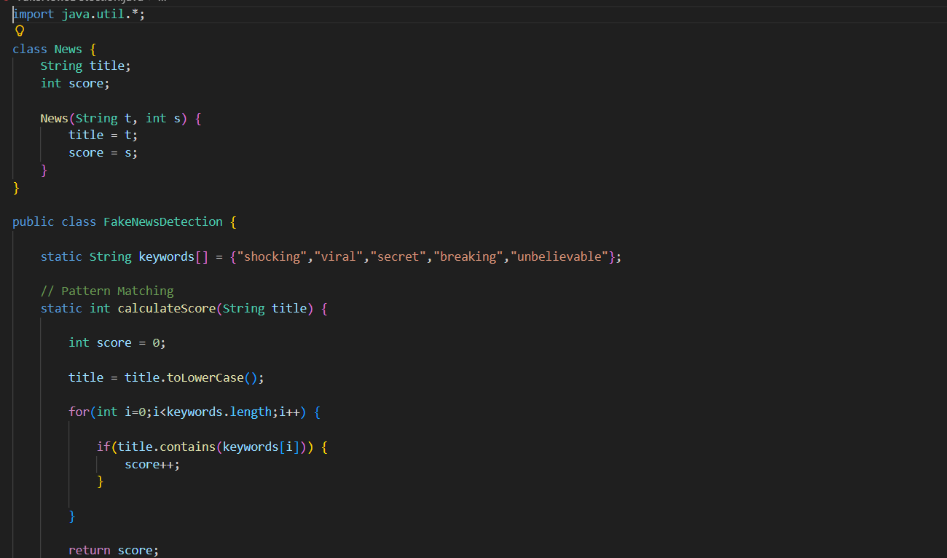
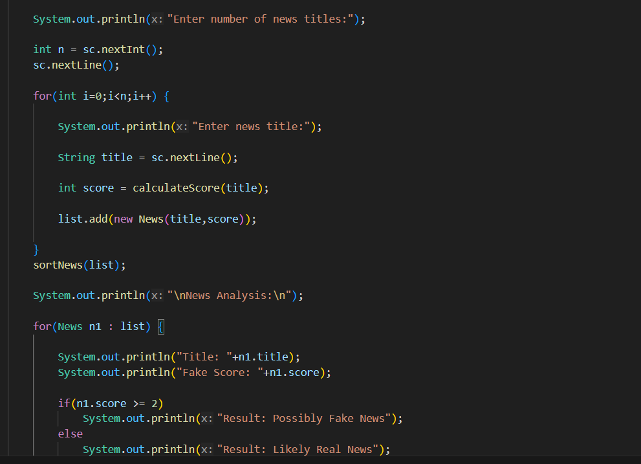
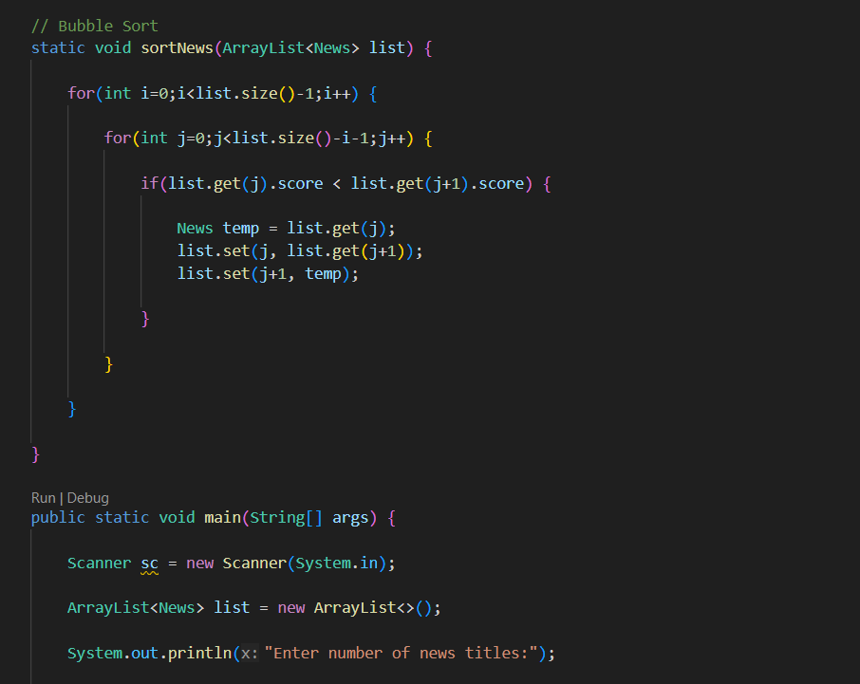
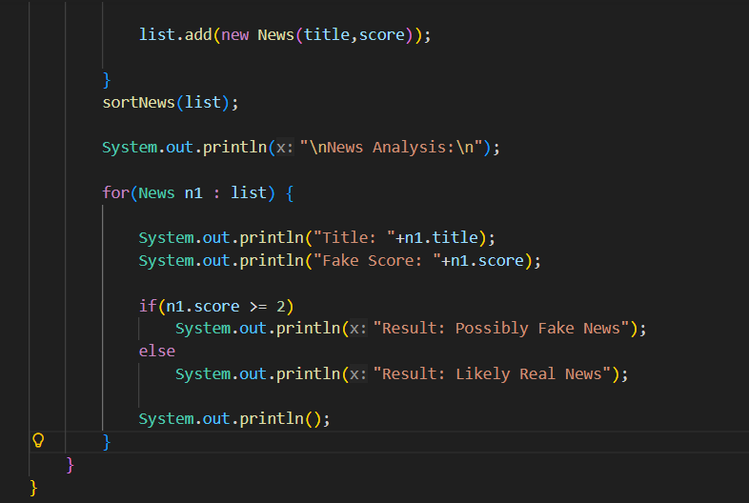
Screenshots for FWD & DSA

Slide 12
Conclusion
The Fake News Detection Using Pattern Matching helps analyze and verify news content to identify fake or misleading information.
The system analyzes the news text and checks for suspicious keywords and patterns commonly found in fake news.
It automatically determines whether the news is likelyfake or geuine.
The project demonstrates the use of HTML, CSS, JavaScript, and basic DSA concepts.
It provides a simple and user-friendly interface for verifying online news content.

Slide 13
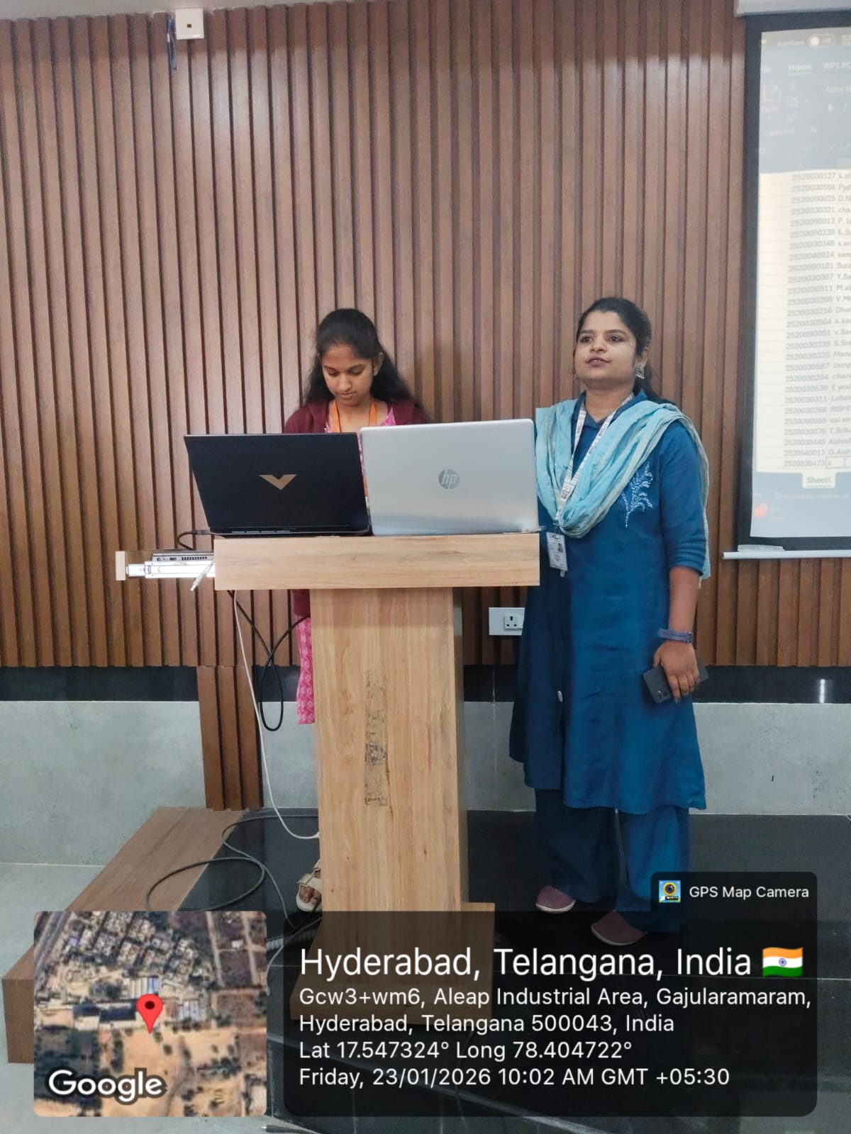
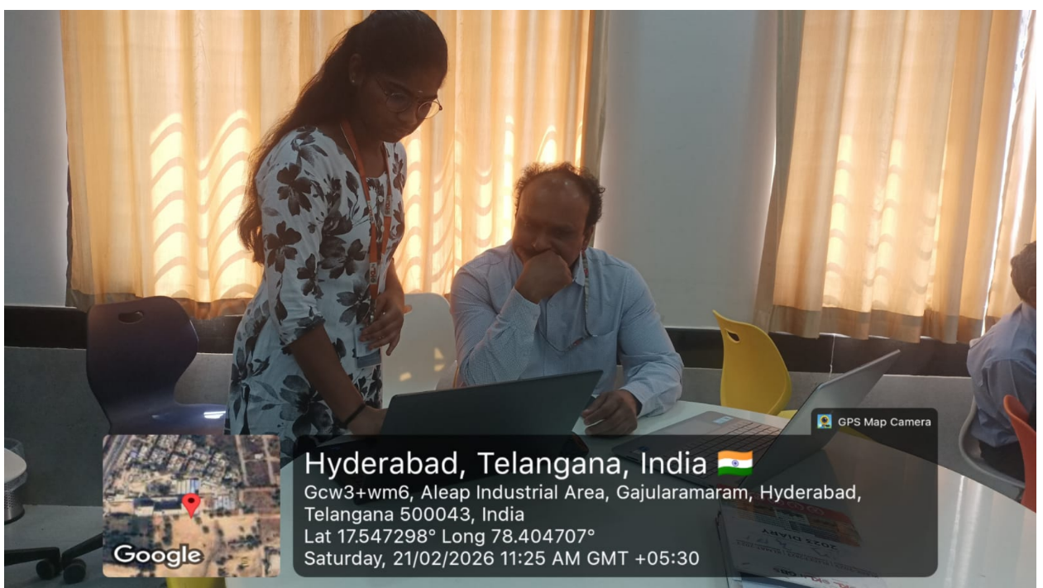
Geo- Tag Photos

Slide 14
THANK YOU

